Slide 1
Insurance Carrier Quarterly Meeting
May 13, 2020
1:30 p.m. to 3 p.m.

Slide 2
Agenda Items
Welcome
Introduction of Deputy Commissioner of Legal Services
Office of Medical Advisor Update
Compliance and Investigations
Telemedicine Update
Workplace Safety Update
MFDR Update
Hearings Update-Zoom
DD and Business Process Update
EDI Monitoring Update
Data Call
Q&A
Closing

Slide 3
Welcome
Cassie Brown, Commissioner Division of Workers’ Compensation

Slide 4
Introduction of Deputy Commissioner of Legal Services
Kara Mace, Deputy Commissioner
Legal Services

Slide 5
Office of Medical Advisor Update
Mary Landrum, Director
Health Care Business Management

Slide 6
Health Care Management Update
Mary Landrum, Director
Health Care Business Management

Slide 7
Medical Quality Reviews
Calendar Year 2020
0 reviews initiated
includes complaint, audit, or monitoring based reviews
assigned to MQRP members for review
5 reviews concluded
80% referred to Enforcement
20% recommended other actions
(includes letters of education, referrals to medical licensing boards, and closures with no action)
Source: Texas Department of Insurance, Division of Workers’ Compensation, data as of 04/21/20

Slide 8
Compliance and Investigations Update
Debra Knight, Deputy Commissioner
Compliance and Investigations

Slide 9
CY2020 Complaints

Slide 10
CY2020 - Complaints
687 Complaints Received
70 Attendance
204 Communications
0 Fraud
150 Indemnity Benefit Delivery
171 Medical Benefit Delivery
48 Other
44 Quality of Care
927 Complaints Closed
225 Confirmed
342 DWC Education Complaint
360 Not Confirmed
*Based on complaint data as of 5/5/2020

Slide 11
Complaint Comparison
Quarter Comparison
Feb 2020 187 | Mar 2020 165 | Apr 2020 89 | Quarter Volume 441
Nov 2019 174 | Dec 2019 294 | Jan 2020 246 | Quarter Volume 714

Slide 12
System Performance

Slide 13
CY2020 – Payment of Initial TIBs and Processing of Medical & Reconsideration Bill
* Based on data as of 4/1/2020
Category | Jan ’20 | Feb ’20 | Mar ’20 | Apr ’20 | May ’20 | Jun ’20 | Jul ’20 | Aug ’20 | Sep ’20 | Oct ’20 | Nov ’20 | Dec ’20
Medical Bill Processing | 98.94% | 99.06% | 99.18%
Reconsideration MB Processing | 90.48% | 96.27% | 96.62%
Initial TIBs Payment | 79.37% | 84.36% | 83.81%

Slide 14
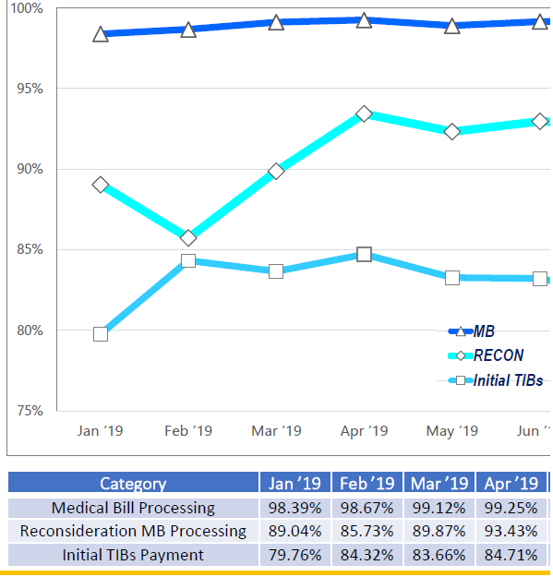
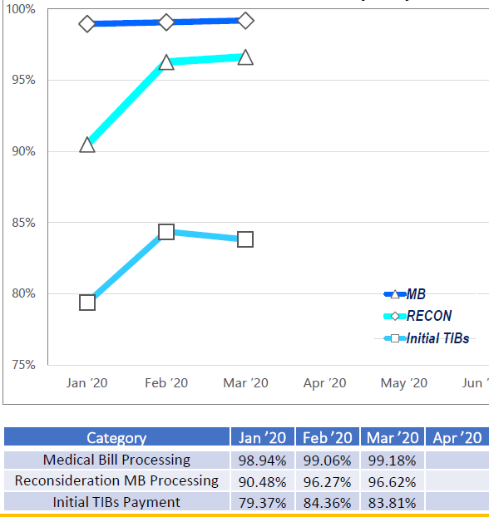
Payment of Initial TIBs and Processing of Medical & Reconsideration Bill
CY2019
CY2020

Slide 15
CY2020 – EDI Reporting of Initial TIBs Payment, Medical Bill and Reconsideration
* Based on data as of 4/1/2020
Category | Jan ’20 | Feb ’20 | Mar ’20 | Apr ’20 | May ’20 | Jun ’20 | Jul ’20 | Aug ’20 | Sep ’20 | Oct ’20 | Nov ’20 | Dec ’20
RECON EDI Reporting | 99.17% | 99.69% | 99.57%
MB EDI Reporting | 98.60% | 98.68% | 98.40%
IP EDI Reporting | 93.75% | 95.69% | 96.47%

Slide 16
DWC Fraud

Slide 17
Fraud Definition
Per Black’s Law Dictionary:
“Fraud includes any intentional or deliberate act to deprive another of property or money by guile, deception, or other unfair means.”
https://www.acfe.com/fraud-101.aspx

Slide 18
Fraud Schemes
Types of fraud the DWC Fraud and Prosecution teams investigate:
Billing for services not performed by attorneys and healthcare providers.
Under reporting employees or misclassifying high risk employees in order to obtain lower premium rates.
Working and drawing.
Falsifying documents to keep from having to pay benefits.

Slide 19
CY2020 – DWC Fraud Stats
487 - Fraud Referrals Received
124 - Fraud Cases Open*
512 - Fraud Cases Closed
0 - Fraud Referrals for Prosecution
*Based on data received as of 4/15/2020

Slide 20
CY2020 – DWC Prosecution Stats
Indictments – 2
1 Healthcare Provider
1 Injured Employee
*Based on data received as of 4/15/2020

Slide 21
CY2020 – DWC Prosecution Stats
Convictions – 2
1 Employer
1 Injured Employee

Slide 22
Enforcement Update

Slide 23
Enforcement Key Initiatives
Strategies DWC Enforcement uses to improve efficiencies in market compliance and case processing:
Using clear, express statutory authority for all enforcement cases.
Informing workers’ compensation stakeholders about compliance goals.
Partnering with DWC program areas to foster compliance.
Assisting the Office of the Medical Advisor.
Providing swift, appropriate actions for statutory and rule violations.

Slide 24
Common Insurance Carrier Administrative Violations
Failure to pay timely indemnity benefits;
Failure to initiate TIBS;
Failure to accurately pay TIBS;
Pursuing a private claim against an injured employee;
Failure to investigate a claim;
Attorney fee billing violations; and
Failure to comply with MFDR or D&O order.

Slide 25
Enforcement Case Status for CY2020
2020 | Closed Cases | Pending Cases
Cases | 193 | 340

Slide 26
Cases Pending by Subject Type as of March 31, 2020
2020 | Health Care Provider | Insurance Carrier | Other
Cases | 80 | 215 | 45

Slide 27
Cases Closed by Disposition Type for CY2020
2020 | Health Care Provider | Insurance Carrier | Other
DWC Order | 4 | 29 | 1
Warning Letter | 27 | 100 | 28
Other | 3 | 1 | 0

Slide 28
Cases Closed by Subject Type for CY2020
2020 | Health Care Provider | Insurance Carrier | Other
Cases | 34 | 130 | 29

Slide 29
OMA Enforcement Cases
CY 2020
2 OMA referrals received in Enforcement
1 OMA case concluded by Enforcement
1 consent orders/final orders
0 warning letters
0 other action
31 OMA cases pending in Enforcement
1 OMA case pending at SOAH
Source: Texas Department of Insurance, Division of Workers’ Compensation, data as of 04/20/20
Notes:
Mary Landrum’s Slide

Slide 30
Telemedicine Update
Matt Zurek, Deputy Commissioner
Health and Safety

Slide 31
Telemedicine 28 TAC §133.30
Rule applies to medical billing and reimbursement for telemedicine and telehealth services provided on or after September 1, 2018.
A health care provider must bill for telemedicine and telehealth services according to applicable:
Medicare payment policies, as defined in §134.203 of this title; and
provisions of Chapter 133 of this title.

Slide 32
Emergency Rule
DWC adopted new 28 Texas Administrative Code §167.1 on an emergency basis. The rule relates to telemedicine and telehealth and went into effect for physical medicine and rehab services provided on or after April 13, 2020.
Rule allows HCP’s licensed to perform physical medicine and rehabilitation services, and physical therapists, occupational therapists, and speech pathologists to bill and be reimbursed for services currently allowed under CMS telemedicine and telehealth billing codes.

Slide 33
Emergency Rule
Under Government Code §2001.034, this emergency rule may not be in effect for more than 120 days but may be extended 60 days.

Slide 34
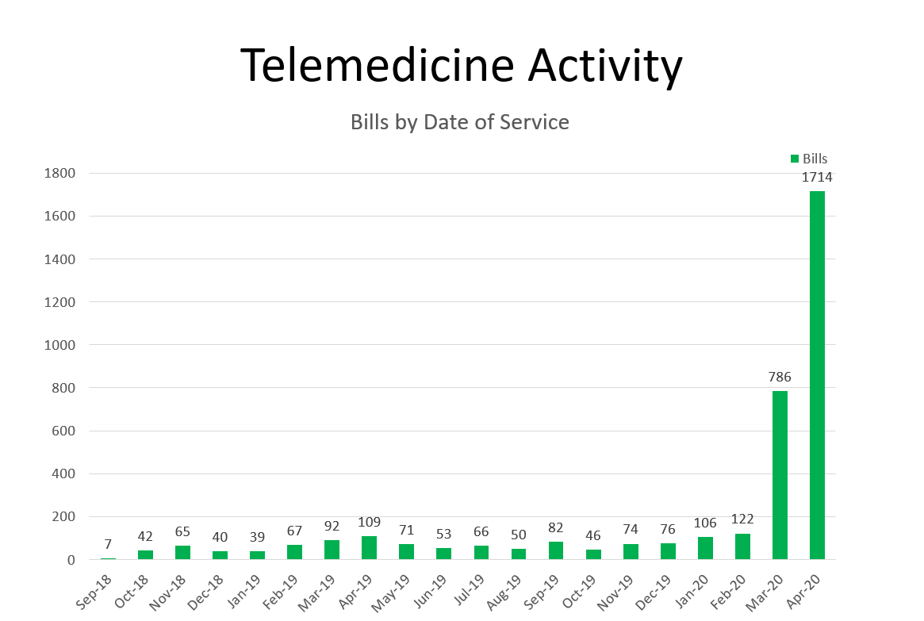

Slide 35
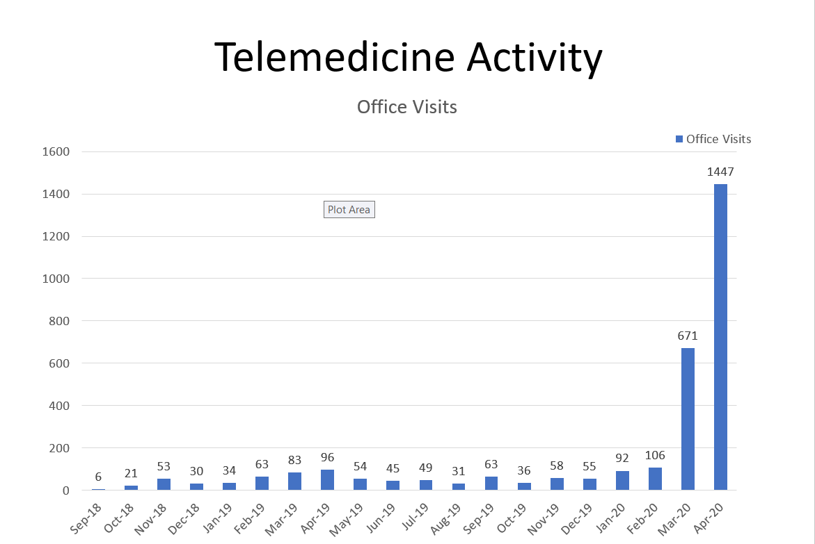

Slide 36
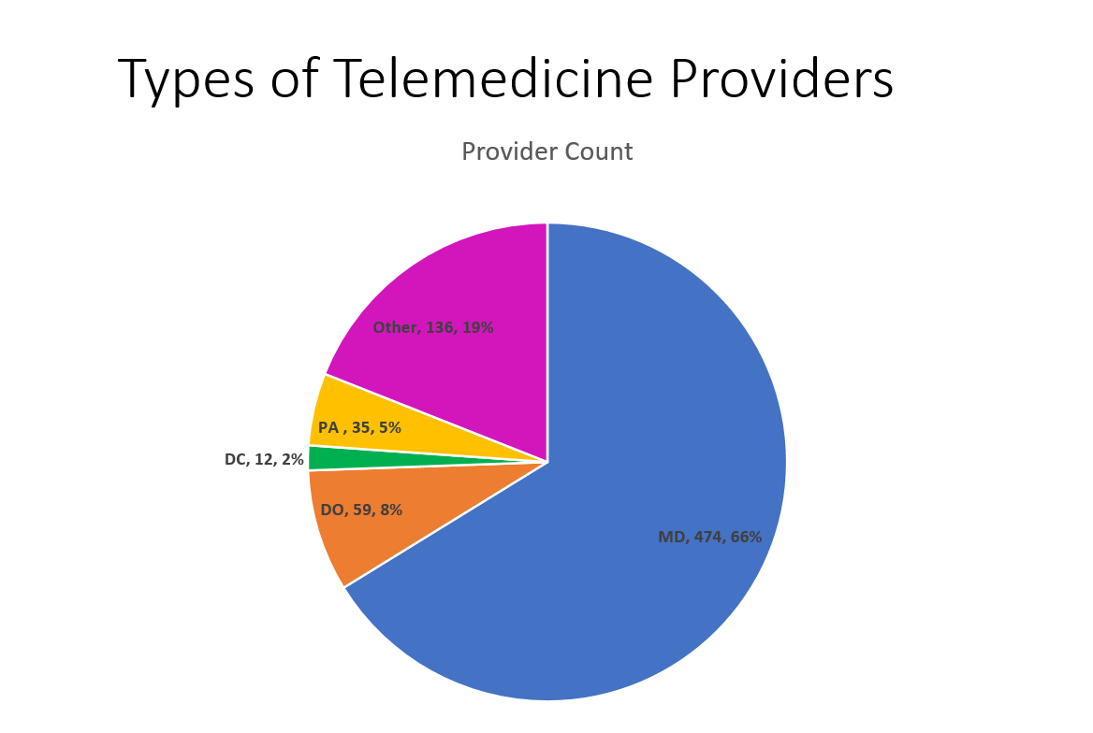

Slide 38
Telemedicine Resources
DWC Telemedicine page:
http://www.tdi.texas.gov/wc/hcprovider/telemed.html
List of covered services:
https://www.cms.gov/Medicare/Medicare-General-Information/Telehealth/Telehealth-Codes
Adopted Rule: (Texas Register)
https://texreg.sos.state.tx.us/public/regviewer$ext.RegPage?sl=R&app=1&p_dir=&p_rloc=351110&p_tloc=&p_ploc=&pg=1&p_reg=351110&ti=28&pt=2&ch=133&rl=30&issue=04/27/2018&z_chk=

Slide 39
Workplace Safety Update
Chris D’Amura, Director
Workplace Safety

Slide 40
Accident Prevention Services
18 Accident Prevention Services Inspections
57 Insurance Companies Inspected
139 Policyholder Visits Conducted
Primary deficiencies identified:
Incomplete inspection documentation
Insufficient loss control procedures

Slide 41
Accident Prevention Services
Annual Reporting Requirements Reminder
Insurance companies that write workers' compensation in Texas must file an initial DWC Form-109, Accident Prevention Services Annual Report, with DWC no later than the effective date of their first workers' compensation insurance policy.
They must file a subsequent annual report by April 1 of each year if active policies were in effect for the preceding calendar year.
The DWC Form-109 must be submitted to DWC by email to aps@tdi.texas.gov.

Slide 42
Texas OSHA Consultation
Consultation Activity Totals 9/1/2019 – 3/1/2020
1134 Employer Consultation Visits
339 Employer Compliance Assistance (Non-Visit activities)
Consultation Activity Totals April 2020
18 Virtual Consultation Visits
264 Employer Compliance Assistance
New virtual visit option available to Texas employers.
1-800-252-7031, Option 2 | OSHCON@tdi.texas.gov
www.txoshcon.com

Slide 43
MFDR Update
Greg Arendt, Director
Medical Fee Dispute

Slide 44
2,120 Disputes Received FY 2020
Pharmacy | Division Specific | Facility | Non-MFDR Issues | Air Ambulance | Professional Services | All Other | Total
367 | 335 | 303 | 275 | 262 | 216 | 362 | 2120

Slide 45
2,180 Disputes Closed FY 2020
Pharmacy | Division Specific | Facility | Non-MFDR Issues | Professional Services | All Other | Total
523 | 377 | 348 | 322 | 259 | 351 | 2180

Slide 46
Average Days to Adjudicate a Dispute
2013 | 2014 | 2015 | 2016 | 2017 | 2018 | 2019 | 2020
1023 | 554 | 289 | 358 | 174 | 68 | 81 | 113

Slide 47
Hearings Update-Zoom
Allen Craddock, Director for
Hearings

Slide 48
FAQs: Requirements
Does each participant require a license? Or just the host?
Only the host (BRO or ALJ) requires a license.
What platforms does Zoom support?
Windows, Mac, Android and iOS

Slide 49
FAQs: Functionality
Will participants be required to use video?
If a party does not have the Zoom app (using traditional phone only), no one will be allowed to use video.
If all parties have the Zoom app, the presiding officer will ask if any party objects to the use of video. (A party may have the Zoom app but may not have the ability to use video – for example, no camera).
If any party objects, the proceeding will be held using only audio.
If no party objects, party’s and participants may use video.
Notes:
Clarify why no Zoom app=no use of video.

Slide 50
FAQs: Functionality
Are the proceedings with Zoom recorded?
BRCs are not recorded.
ALJs will record CCHs with Zoom.
The official record of the CCH will be a sound file only (except when there is a court reporter).
The video will not be saved.

Slide 51
FAQs: Functionality
While someone is in the breakout room, can they see/hear the proceedings in the main meeting?
They cannot, and participants in the main room cannot see/hear what is happening in the breakout room.
The breakout room cannot be recorded.

Slide 52
FAQs: Functionality
What if there are computer or phone problems during a proceeding?
If a party is disconnected, the other parties should stay on the line for instructions from the ALJ.
If your connection drops:
Click on the Zoom link, or
Call back in using the Zoom telephone number you were provided for this hearing.
If you can’t reconnect, call the Hearings staff at 512-804-4010.
If the ALJ’s connection drops:
Wait in the Zoom room and do not talk with the other parties about the case.
If I can’t reconnect, the Hearings staff will call you with further instructions or to reschedule the hearing.

Slide 53
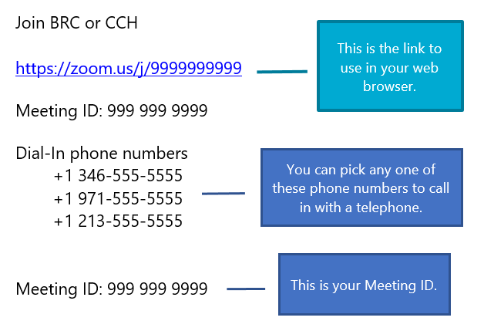
Joining a BRC or CCH by Phone
Notes:
Information previously provided. Here is an over how participnats join.

Slide 54
Joining a BRC or CCH by Phone
Using a phone to dial in is useful when:
You do not have a microphone or speaker on your computer;
You cannot connect to the internet; or
Your internet connection is weak.

Slide 55
Joining a BRC or CCH by Phone
You will need the dial-in phone number and Meeting ID.
Dial one of the phone numbers provided.
You will be prompted to enter the Meeting ID followed by #.
If the meeting has not already started, you will be prompted to press # to wait.
You will be prompted to enter your unique participant ID. This does not apply if you are calling in by telephone, so you can press # to skip.

Slide 56
Joining a BRC or CCH by Phone
Phone controls for participants
You can enter the following commands using your phone's keypad:
*6 to mute and unmute
*9 to raise your hand (request to be recognized by the presiding officer)

Slide 57
Joining a BRC or CCH by App
Open the Zoom app
Click Join a Meeting if you want to join without signing in.
Sign in to Zoom then click Join.

Slide 58
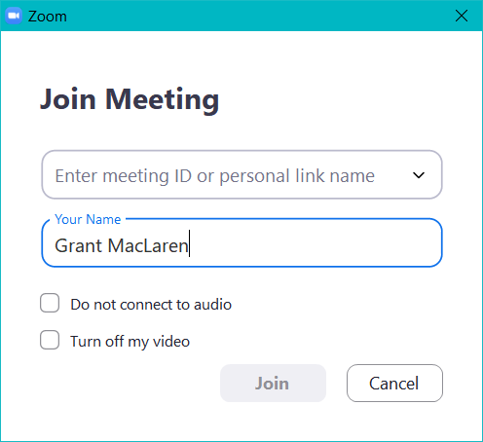
Joining a BRC or CCH by App
Enter the Meeting ID and your display name.
If you're signed in, your name should already appear.
If you're not signed in, enter a display name.
Check Turn off my video and click Join.

Slide 59
BRC Exchanges & CCH Exhibits
You are responsible for making sure that anything you send electronically is done securely.

Slide 60
BRC Exchanges & CCH Exhibits
Email
For BRC exchanges, email to BRC_Exchanges@tdi.texas.gov. Please note, the underscore between BRC and Exchanges.
For CCH exhibits, email to CCH_Exhibits@tdi.texas.gov. Please note the underscore between CCH and Exhibits.

Slide 61
BRC Exchanges & CCH Exhibits
Fax to 512-804-4011.
Please break the fax into sections (faxes over 40 pages sometimes get interrupted).
Place a cover page on each section identifying the claim number and which section it is (for example, Section 1 of 4, Section 2 of 4, etc.).

Slide 62
BRC Exchanges & CCH Exhibits
Secure File Transfer Protocol (SFTP)
If you have an account with DWC, you can upload BRC exchanges and CCH exhibits by SFTP.
Naming conventions for files are provided to parties when they sign up for an SFTP account.
If you need an SFTP account, we can provide one to you. Contact Theol Jackman at:
theol.jackman@tdi.texas.gov or
512-804-4308.

Slide 63
BRC Exchanges & CCH Exhibits
Parties may exchange documents electronically with other parties, including with injured employees who have email addresses or fax numbers and agree to receive these documents electronically.
DWC encourages parties to use fax or encrypted email and also ensure that injured employees can access exchanged documents sent electronically.
CCH exhibits should be filed with DWC and exchanged with other parties at least three business days before the hearing.

Slide 64
Tips for Successful Hearings
Using Video
Dress in a soft solid color. If a tie is worn, use a solid tie rather than one with a pattern.
When speaking, remember to look directly at the webcam, not at the screen.
Position the camera at your eye level or slightly above eye level.
Be mindful of what is behind you. If you can’t use the virtual background, choose a solid neutral wall if possible.
Virtual backgrounds should not be distracting.

Slide 65
Tips for Successful Hearings
Using Video
Check the lighting.
Light from behind you might blind the camera.
Light above you might cast shadows.
Ideally, position a lamp, or sit facing a window, where light is directly on your face.
Speak one at a time and pause prior to speaking in case there is any audio/video lag.
Mute yourself when not speaking in order to avoid any potential background noise.
Test your connection and setup with Zoom
https://zoom.us/test

Slide 66
Questions?
If you have questions or need additional information about participating in BRCs and CCHs by Zoom, contact Allen Craddock at:
Allen.Craddock@tdi.texas.gov or
512-804-4085.

Slide 67
DD and Business Process Update
Joe McElrath, Deputy Commissioner
Business Process

Slide 68
EDI Monitoring Update
Joe McElrath, Deputy Commissioner
Business Process
Martha Luevano, Director
EDI Automation Services

Slide 69
Data Call
Amy Lee, Special Advisor | Director
Research and Evaluation Group

Slide 70
Proposed Data Submission Timeframes
What to Submit | Submission Deadline to DWC
COVID-19 injuries reported to the insurance carrier from December 1, 2019 through June 30th and payments made on those injuries as of June 30th. | August 15, 2020
COVID-19 injuries reported to the insurance carrier from December 1, 2019 through September 30th and payments made on those injuries as of September 30th. | October 31, 2020
COVID-19 injuries reported to the insurance carrier from December 1, 2019 through December 31st and payments made on those injuries as of December 31st. | January 31, 2021

Slide 71
COVID-19 Information Requested (as of December 1, 2019)
Number of claimants with COVID-19 exposures reported
Number of claimants with confirmed COVID-19 positive test or diagnosis
Total $ paid in medical benefits for COVID-19 claims
Total $ paid in income benefits (TIBs, IIBs, SIBs, or LIBs) for COVID-19 claims
Total $ paid in death benefits for COVID-19 claims
Total $ in burial benefits for COVID-19 claims

Slide 72
Selected Insurance Carriers
State of Texas workers’ compensation programs
Selected cities, counties, hospital districts
Intergovernmental risk pools
Selected insurance company groups
May include a couple of certified self-insureds

Slide 73
Questions?

Slide 74
Q&A

Slide 75
Closing
Cassie Brown, Commissioner
Division of Workers’ Compensation

